Slide 1
Indifference Curve Analysis

Slide 2
Indifference Curves
An indifference curve is a set of points with the same utility. That is, utility is constant along an indifference curve.
A curve showing all the combinations of two goods that the consumer is indifferent among.
Copyright © Houghton Mifflin Company. All rights reserved.

Slide 3
Assumption of Indifference Curve
Completeness
Non-satiation
Consistency or transitivity
Continuity or Substitutability
Convexity
Copyright © Houghton Mifflin Company. All rights reserved.

Slide 4
Properties of Indifference Curve
Indifference Curve slope downward to the right.
Indifference Curves are convex to the origin
Indifference Curve cannot intersect each other.
A higher indifference curve represents higher level of satisfaction than the lower indifference curve.
Copyright © Houghton Mifflin Company. All rights reserved.

Slide 5
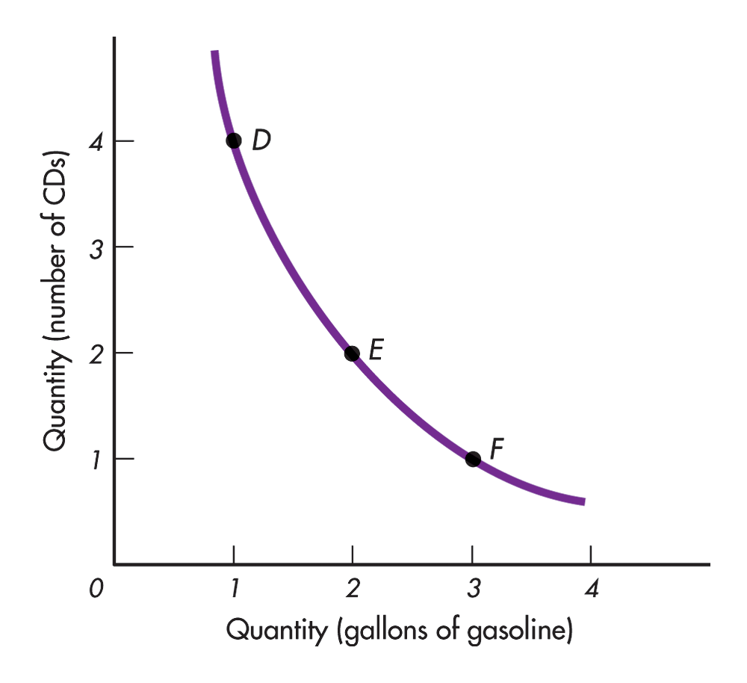
Indifference Curve slope downward to the right
Indifference curve downward sloping means that when the amount of one good in the combination is increased, the amount of the other good is reduced.
APPLES
MANGO
Copyright © Houghton Mifflin Company. All rights reserved.

Slide 6
Indifference Curves are convex to the origin
In the other words, the indifference curve is relatively flatter in its right-hand portion and relatively steeper in its left hand portion.
APPLES
MANGO
Copyright © Houghton Mifflin Company. All rights reserved.

Slide 7
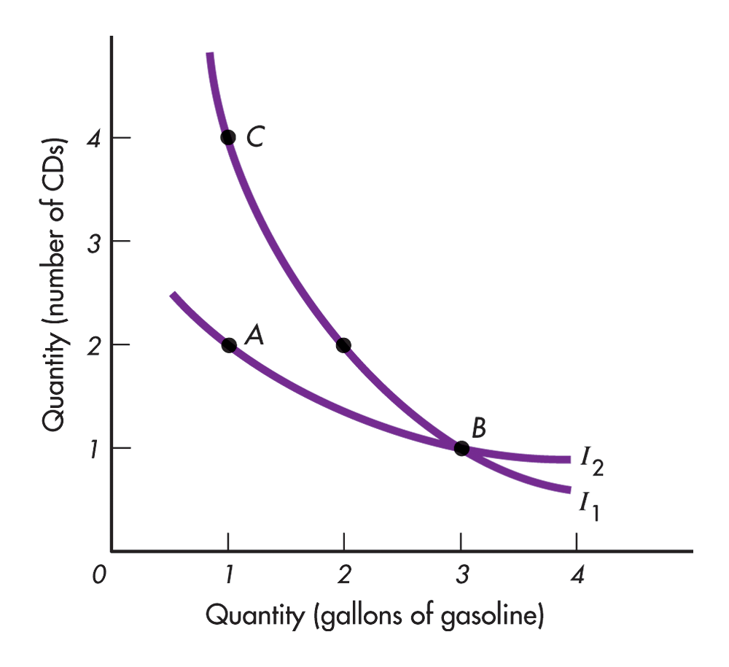
Indifference Curve cannot intersect each other
If the curves crossed, it would mean that the same bundle of goods would offer two different levels of satisfaction at the
same time.
APPLES
MANGOES
Copyright © Houghton Mifflin Company. All rights reserved.

Slide 8
Indifference Curve cannot intersect each other
If the curves crossed, it would mean that the same bundle of goods would offer two different levels of satisfaction at the same time.
If we allow that the consumer is indifferent to all points on both curves, then the consumer must not prefer more to less.
There is no way to sort this out. The consumer could not do this and remain a rational consumer.
Copyright © Houghton Mifflin Company. All rights reserved.

Slide 9
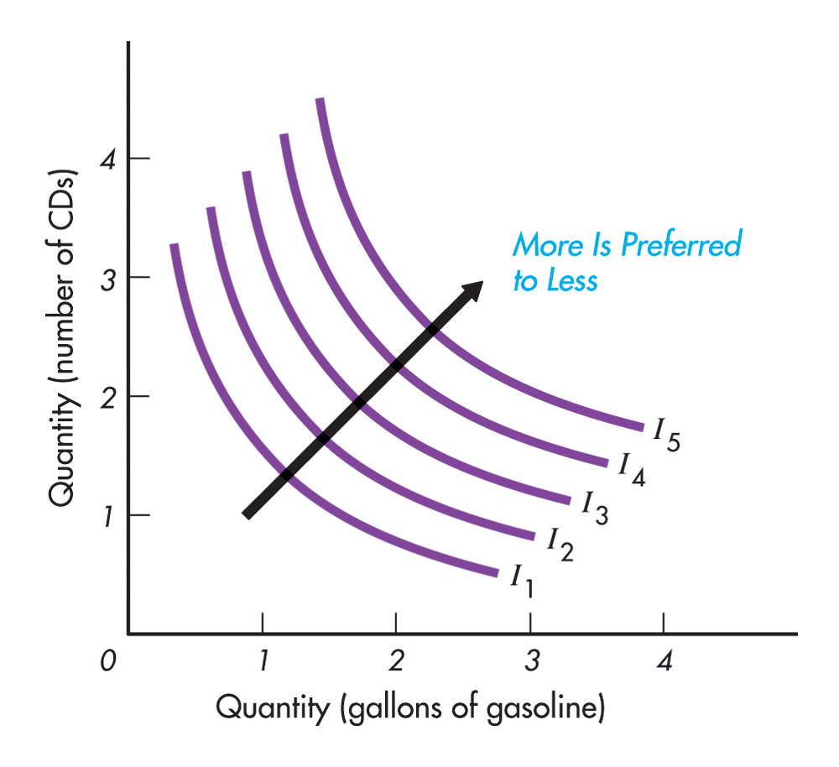
A higher indifference curve represents higher level of satisfaction
The last property of indifference curve is that a higher indifference curve represents higher level of satisfaction than a lower indifference curve.
APPLES
MANGOES
Copyright © Houghton Mifflin Company. All rights reserved.

Slide 10
A higher indifference curve represents higher level of satisfaction
An indifference map is a complete set of indifference curves.
It indicates the consumer’s preferences among all combinations of goods and services.
The farther from the origin the indifference curve is, the more the combinations of goods along that curve are preferred.
Copyright © Houghton Mifflin Company. All rights reserved.

Slide 11
Budget Constraint
The indifference map only reveals the ordering of consumer preferences among bundles of goods. It tells us what the consumer is willing to buy.
It does not tell us what the consumer is able to buy. It does not tell us anything about the consumer’s buying power.
The budget line shows all the combinations of goods that can be purchased with a given level of income.
Copyright © Houghton Mifflin Company. All rights reserved.

Slide 12
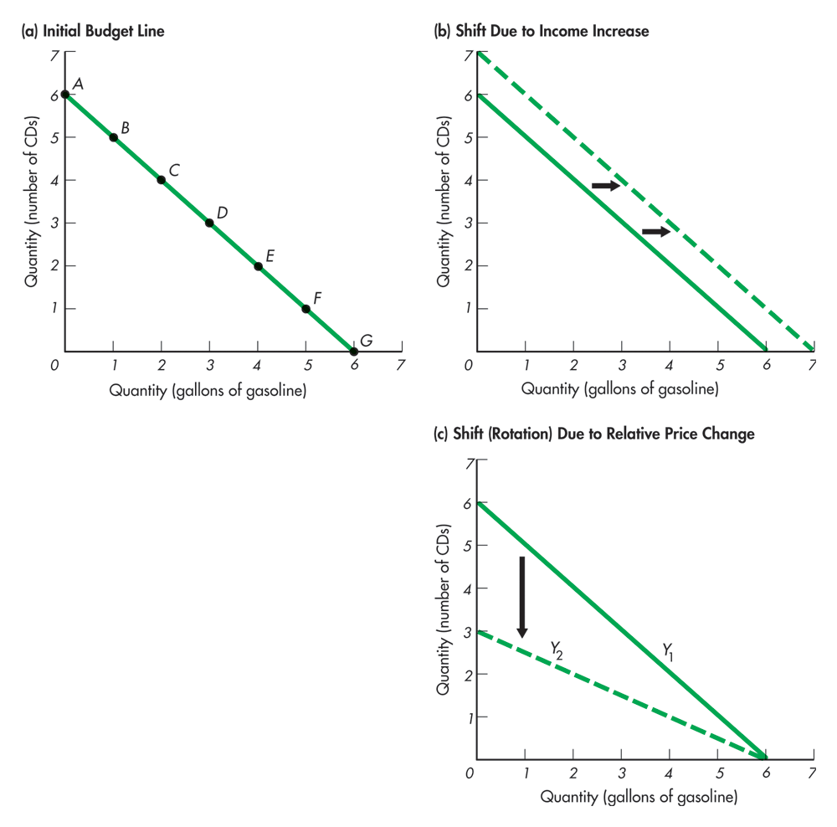
The
Budget Line
APPLES
APPLES
MANGOES
MANGOES
APPLES
MANGOES
Copyright © Houghton Mifflin Company. All rights reserved.

Slide 13
Consumer Equilibrium
The indifference map in combination with the budget line allows us to determine the one combination of goods and services that the consumer most wants and is able to purchase. This is the consumer equilibrium.
The demand curve for a good can be derived from indifference curves and budget lines by changing the price of one of the goods (leaving everything else the same) and finding the equilibrium points.
Copyright © Houghton Mifflin Company. All rights reserved.

Slide 14
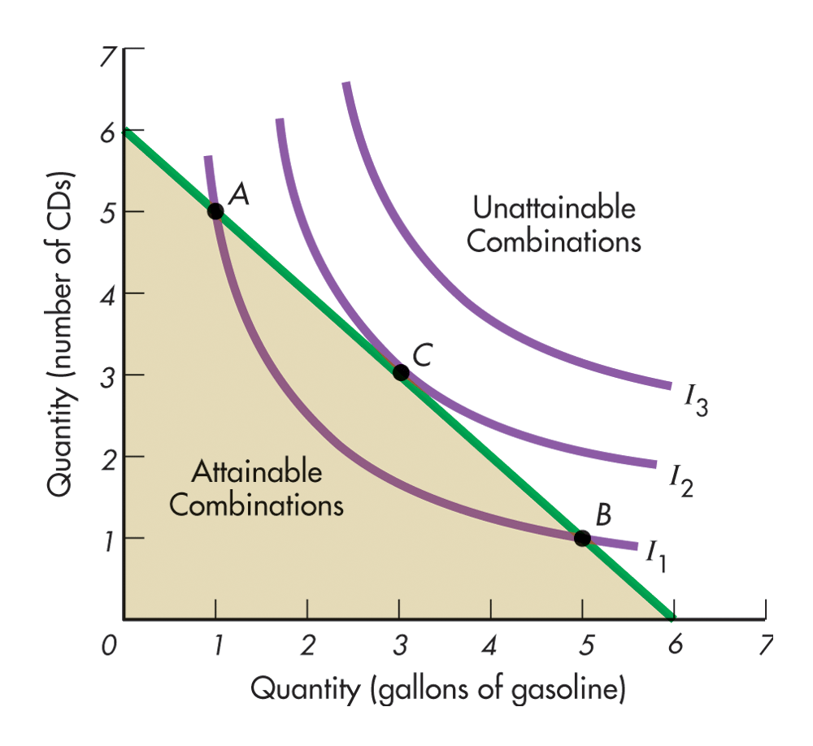
Consumer Equilibrium
The consumer maximizes satisfaction by purchasing the combination of goods that is on the indifference curve farthest from the origin but attainable given the consumer’s budget.
APPLES
MANGOES
Copyright © Houghton Mifflin Company. All rights reserved.

Slide 15
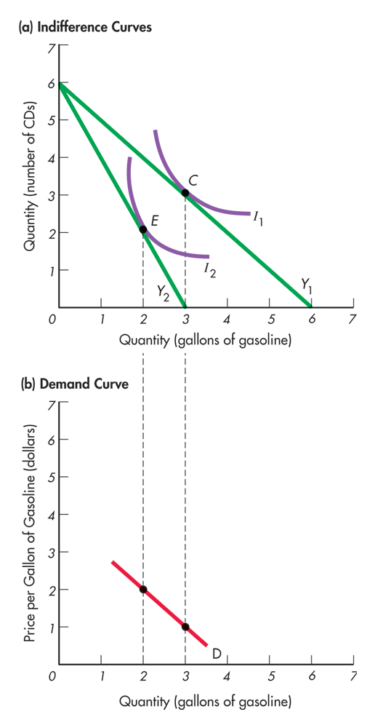
Deriving the Demand Curve
APPLES
By changing the price of one of the goods and leaving everything else the same, we can derive the demand curve.
In (a), the price of a mango doubles, rotating the budget line from Y₁ to Y_{2.} The consumer equilibrium moves from point C to E, and the quantity demanded of mangoes falls from 3 to 2.
MANGOES
PRICE
MANGOES
Copyright © Houghton Mifflin Company. All rights reserved.

Slide 16
CONCLUSION

Slide 17
?
Copyright © Houghton Mifflin Company. All rights reserved.

